Slide 1
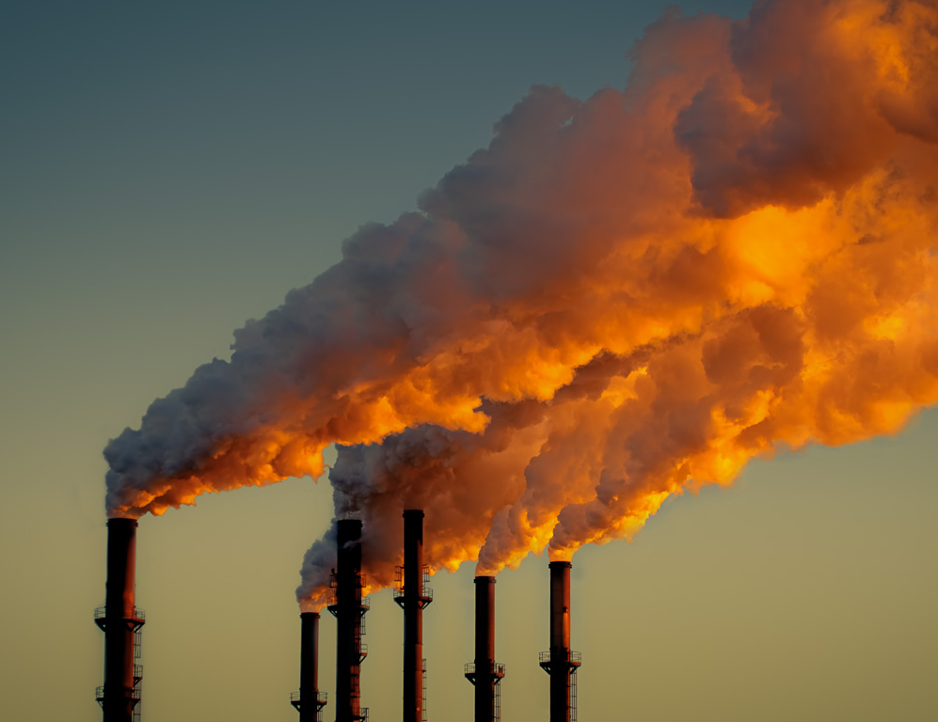
The Problem
Humans activities are releasing carbon dioxide, methane, and other greenhouse gases into the atmosphere. This is warming the Earth’s climate at a dangerous rate.

Slide 2
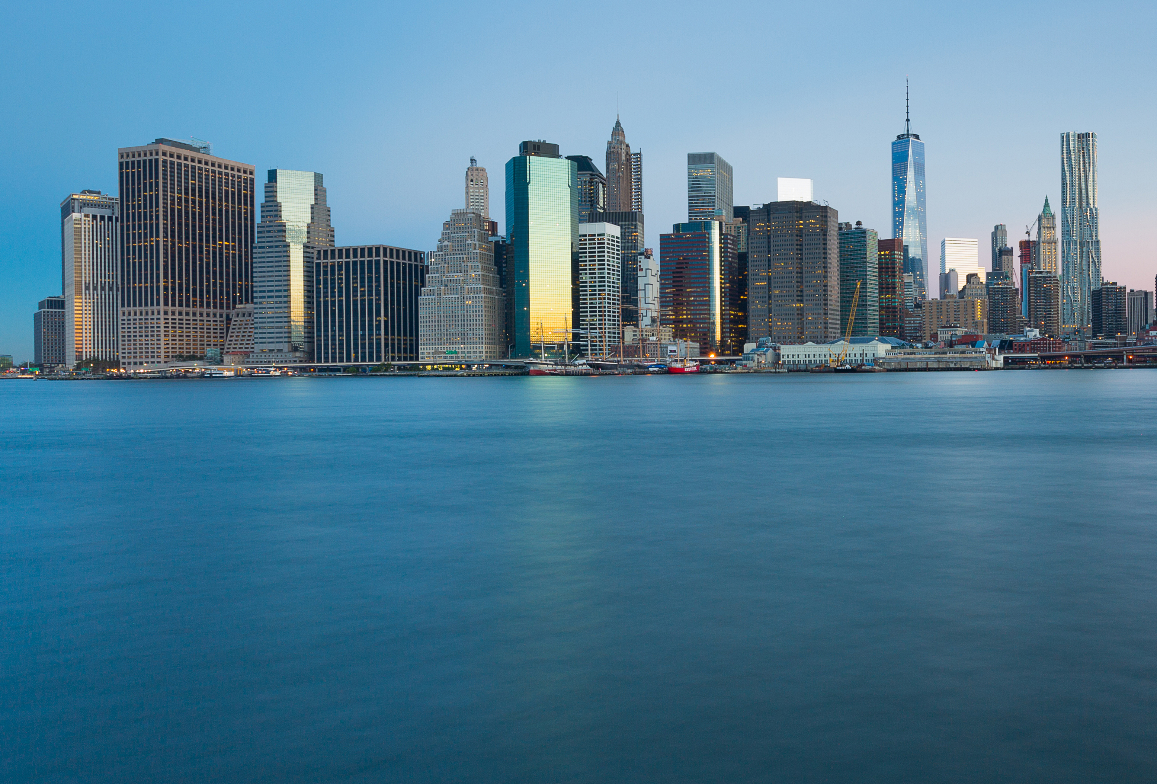
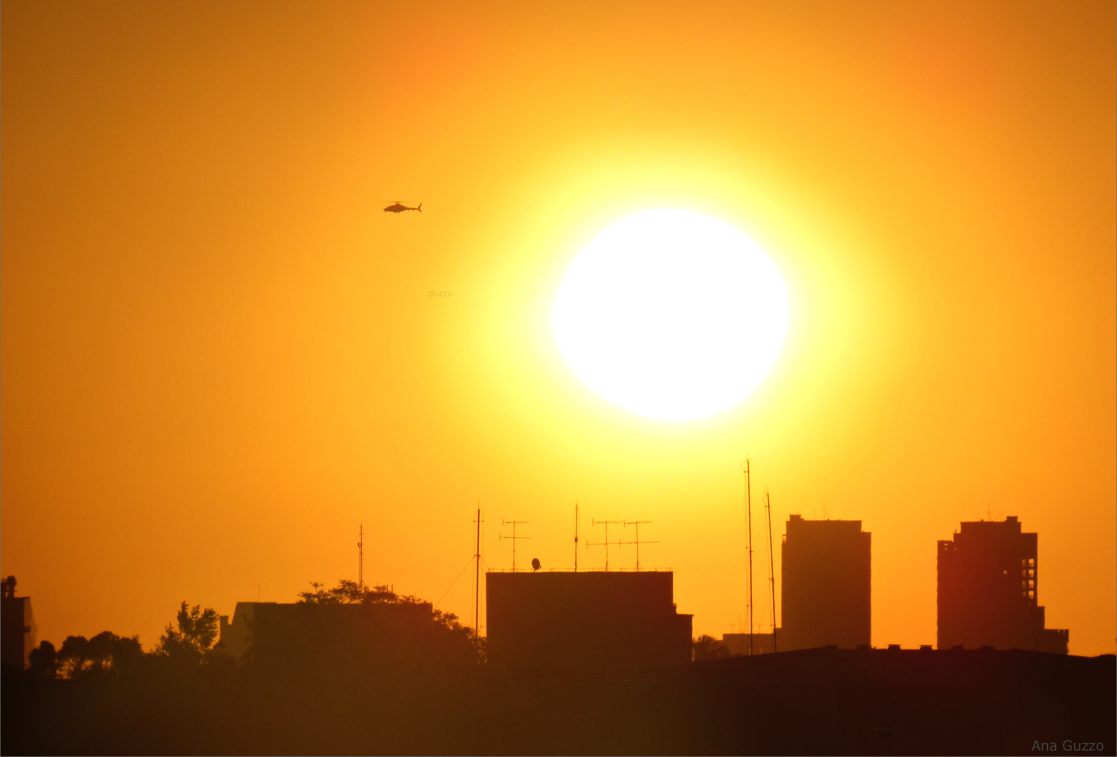
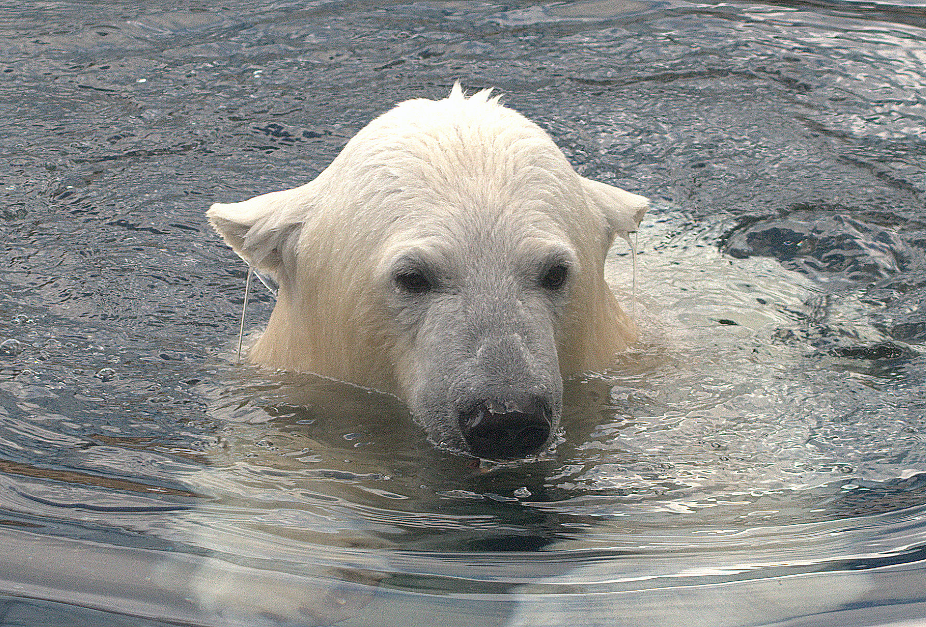
Consequences
Sea Level Rise
Because the ice caps are melting, sea level is rising. This threatens the survival of coastal cities and communities.
1
Hotter Temperatures
Heat waves are becoming more intense and frequent. This threatens the health of people, crops, livestock, and pets.
2
Mass Extinction
Many species are already struggling to cope with climate change. One in six may go extinct by the end of the century.
3

Slide 3
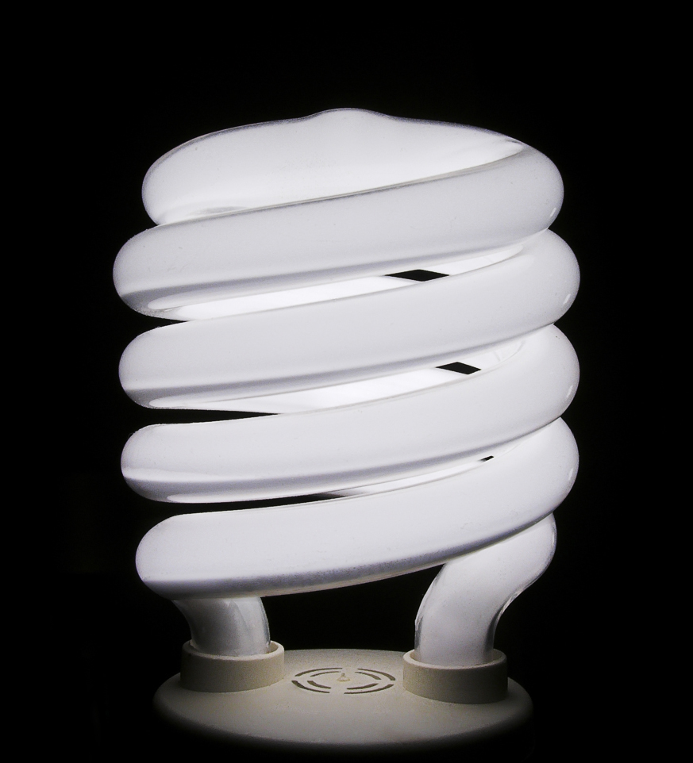

1
What Can You Do about It?
Reduce Energy Use
Choose light bulbs and appliances with ENERGY STAR® labels. They use much less energy than standard products.
Turn off lights, TVs, and other devices when they’re not being used.
Adjust your thermostat to reduce heating or cooling when you’re not at home. Make sure your house is properly sealed and insulated.

Slide 4
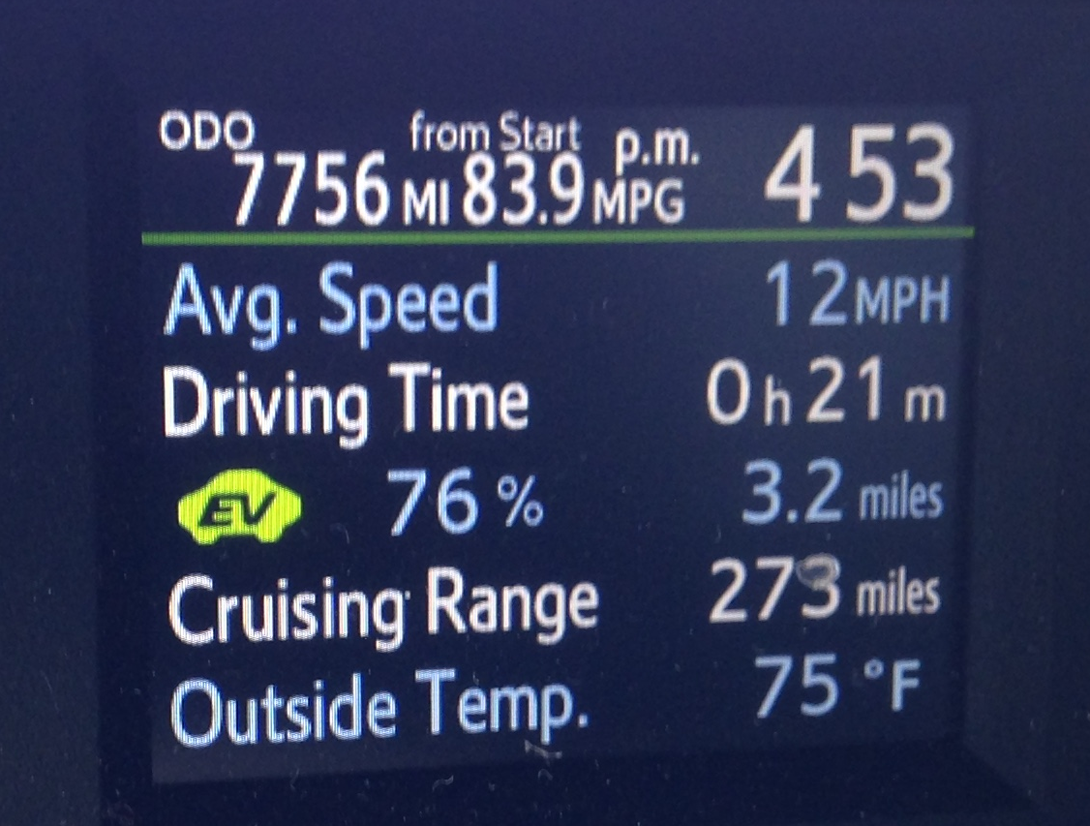
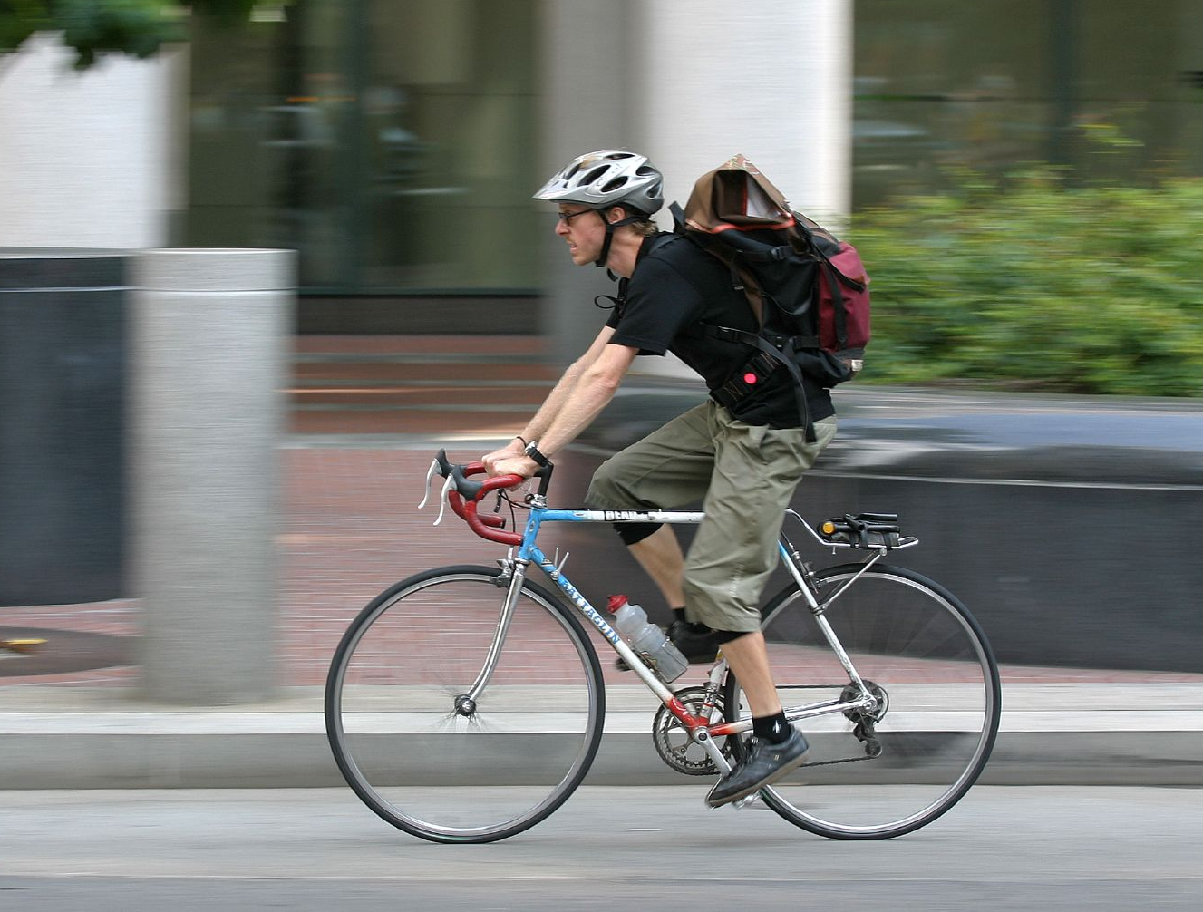
2
What Can You Do about It?
Drive Smart, Drive Less
Buy a fuel-efficient vehicle.
Go easy on the brakes and gas pedal, and use cruise control when you can. Sudden starts and stops burn more gas.
Lighten the load. Take out anything you don’t need from your trunk and keep your tires properly inflated.
Use public transportation, carpool, bike or walk when you can.

Slide 5
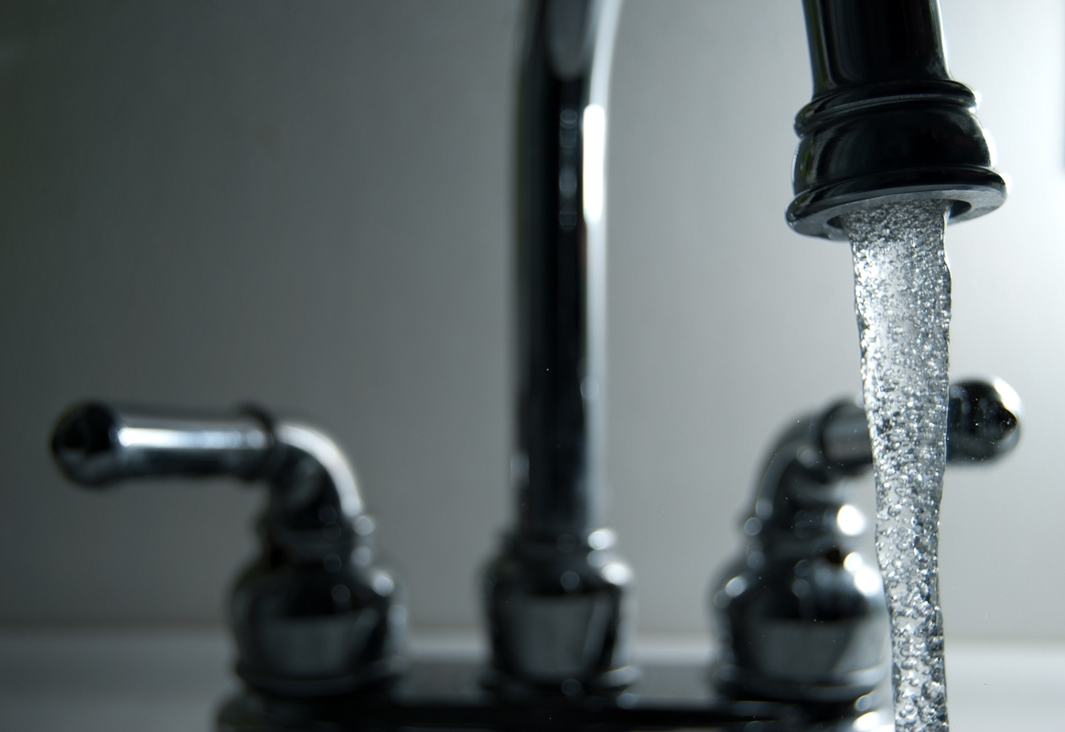

3
What Can You Do about It?
Reduce, Reuse, Recycle
You can fight climate change by the choices you make everyday!
Don’t waste water. Water treatment takes energy and burns more fossil fuels.
Choose tap water over bottled water. Tap water is just as safe and doesn’t require packaging and transportation.
Go paperless and save trees! Opt for electronic statements and communications.
Recycle paper, beverage containers, and other goods. Properly dispose of electronics.

Slide 6

Photo Credits
Photos used under Creative Commons licenses:
https://creativecommons.org/licenses/by-nc-nd/2.0/legalcode
“Smoke Stack from Sugar Factory in Belle Glade Florida” by Kim Seng via flickr.com (cropped)
“Manhattan Blue” by melfoody via flickr.com (cropped)
“My Ears Are Leaking” by Valerie via flickr.com
“2010-Handa-Insight-Hybrid-EX_091” by Brian Hoecht via flickr.com
https://creativecommons.org/licenses/by-nc/2.0/legalcode
“Untitled” (Sun) Ana Guzzo via flickr.com (cropped)
“Bicycle Messenger” by Thoams Hawk via flickr.com (cropped)
https://creativecommons.org/licenses/by-sa/3.0//legalcode
"Compact-Fluorescent-Bulb" by PiccoloNamek via http://en.wikipedia.org
https://creativecommons.org/licenses/by/2.0//legalcode
”Running Faucet" by Steve Johnson via flickr.com

